Slide 1
Assignment 1
ETC3450: Applied Time Series Econometrics
Ali Alkhatib 34395873

Slide 2
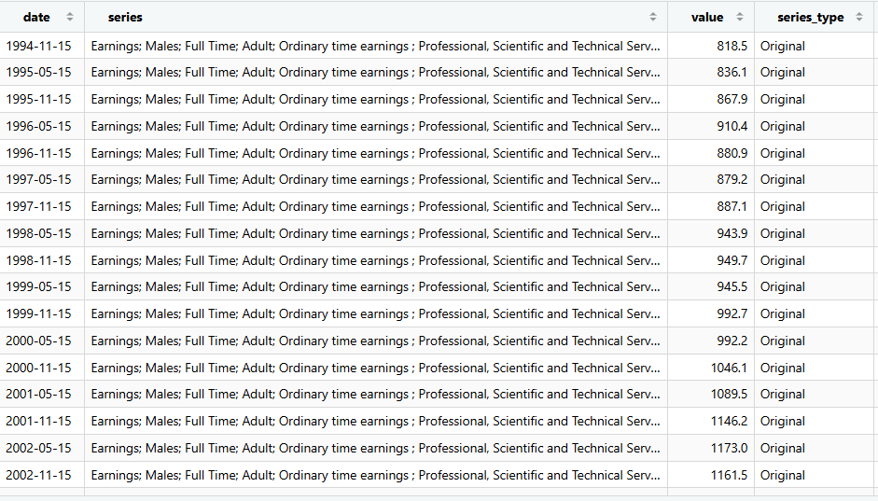
Series Summary
What we're analysing: Average earnings for male professionals in Scientific & Technical Services (ABS series data, A84977991W, 2005-2022)
The goal: Understand the behavior of this earnings series and forecast where it's headed over the next 2 years
Tools: R-code
Our approach (The data):
  Examine the raw series and its first difference
  Test formally whether each is stationary or non-stationary
  Fit/Find and compare two forecasting models per series
  Produce forecasts with prediction intervals

Slide 3
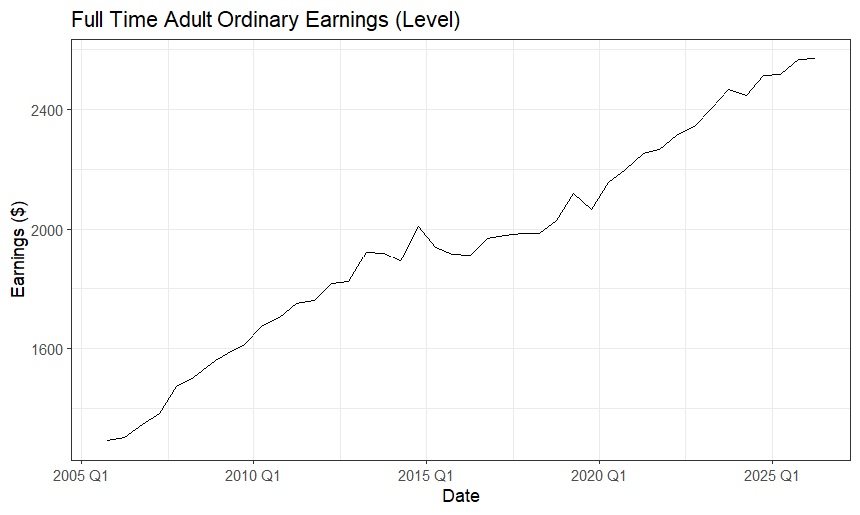

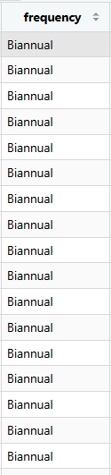
Level – Full-Time Adult Ordinary Earnings
R.W w/ Drift
U
T

Slide 4
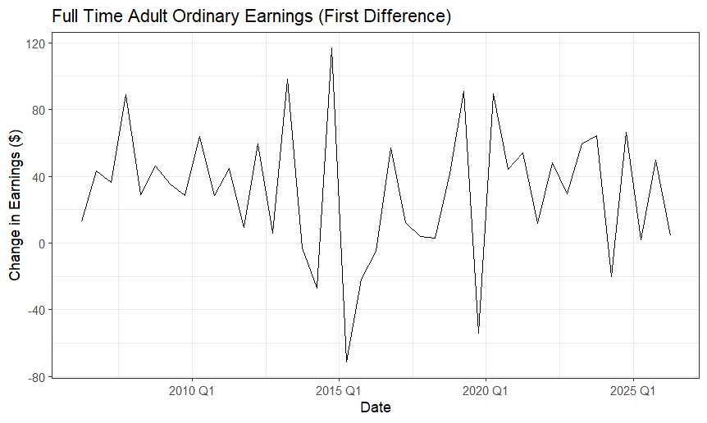
1st Difference – Full-time Adult Ordinary Earnings

Slide 5
1st Difference – Full-time Adult Ordinary Earnings
(μ) = 40

Slide 6
1st Difference – Full-time Adult Ordinary Earnings
(μ) = 40
Mean (μ) is about 40 (greater than 0)
→ Random Walk w/ Drift

Slide 7
Level - ACF & PACF

Slide 8
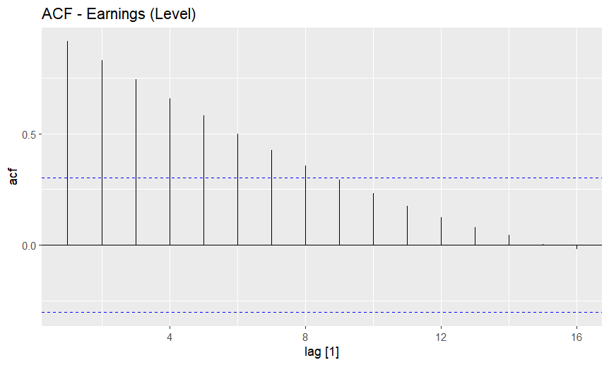
Level - ACF
Decay – have to look at PACF

Slide 9
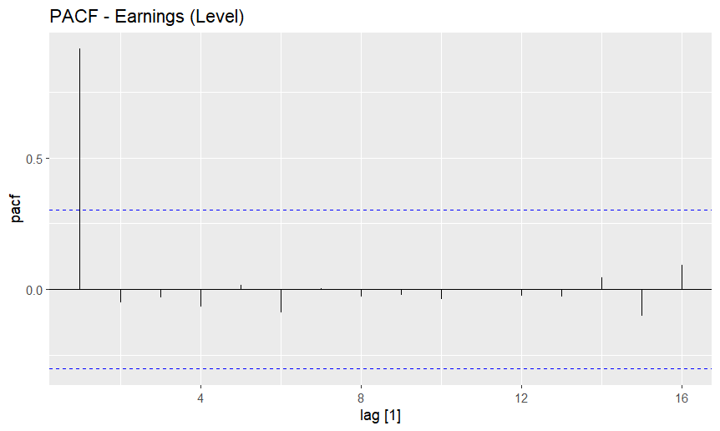
Level - PACF
Indicates AR(1) model

Slide 10
1st Difference - ACF & PACF

Slide 11
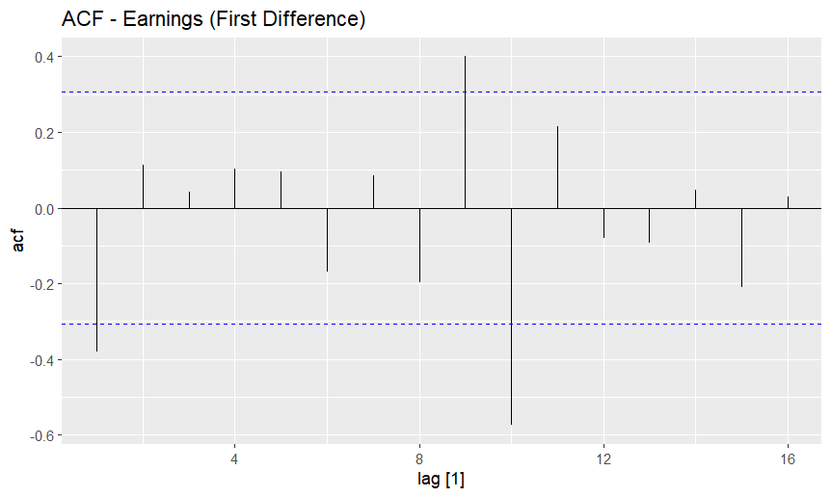
1st Difference - ACF
Lag @ [9,10] indicate structural break
No clear cutoff

Slide 12
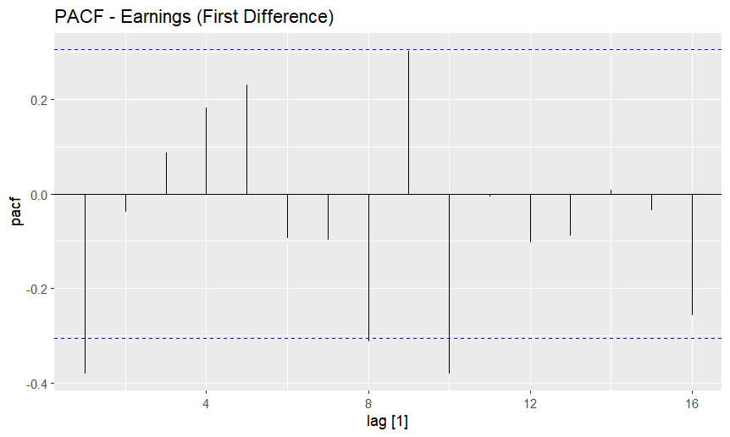
1st Difference - PACF
Lag @ [8,10] indicate structural break
Neither ACF and PACF show clean cutoff
Lag @ [1] indicates Short-run dependence

Slide 13
Level Series Tests

Slide 14
Formal ADF Hypothesis Testing
ADF asks, “is the series non-stationary?”

Slide 15
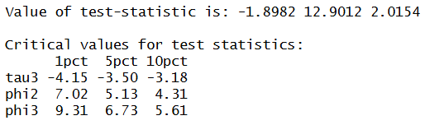
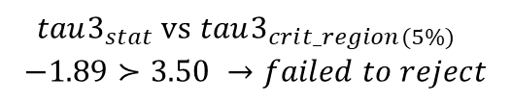
Level – ADF Unit Root Test
ADF test
$$tau3_{stat}\text{ vs} tau3_{cri{t_region(5\%)}_{}}$$
$$−1.89≻3.50 →failed to reject$$
Ambiguous reading - doesn’t technically confirm anything but if KPPS doesn’t reject either, the answer is also ambiguous but its highly suggestive the level may be non-stationary

Slide 16
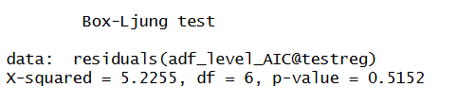
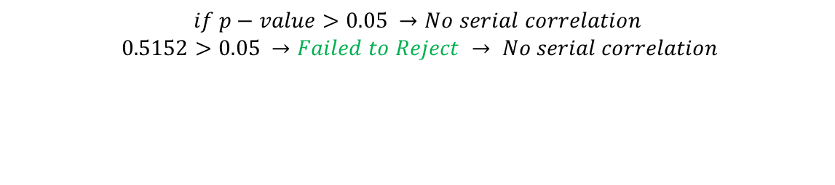
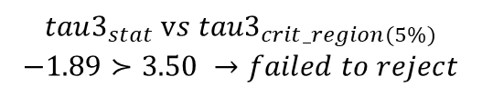
Level – ADF Unit Root Test
ADF test
Box-Ljung test
Test serial correlation for ADF test:
$$if p−value>0.05 →No serial correlation$$
$$0.5152>0.05 →Failed to Reject → No serial correlation$$
$$tau3_{stat}\text{ v}s{ tau3}_{crit_region(5\%)}$$
$$−1.89≻3.50 →failed to reject$$
Errors are not serial correlated – this is expected from ADF test.
Errors are sufficiently white noise (pure random)
Model has extracted all predictable structure from series with only 1 lag term (via AIC selection)
Null Hypothesis of “there is a unit root”
Ambiguous reading - doesn’t technically confirm anything but if KPPS doesn’t reject either, the answer is also ambiguous but its highly suggestive the level may be non-stationary

Slide 17
Formal KPSS Hypothesis Testing
KPSS asks, “is the series stationary?”

Slide 18
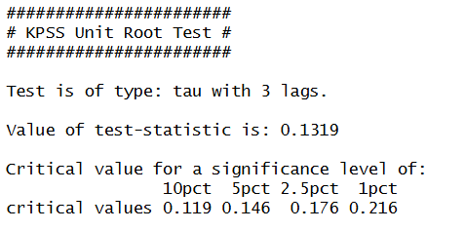
Level – KPSS TEST

Slide 19

Level – KPSS TEST
KPSS test
$${tau3}_{KPSS_stat} vs {tau3}_{crit_region(5\%)}$$
$$0.13<0.14 →failed to reject$$
Ambiguous reading again
Highly suggestive the level may be non-stationary

Slide 20
1ST ▲ Series Tests

Slide 21
Formal ADF Hypothesis Testing
ADF asks, “is the series non-stationary?”

Slide 22
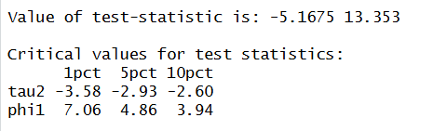
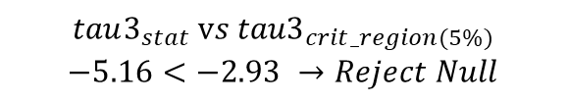
1st ▲ – ADF Unit Root Test
ADF test
$$tau3_{stat}\text{ v}s{ tau3}_{crit_region(5\%)}$$
$$−5.16<−2.93 →Reject Null$$
Null Hypothesis of “there is a unit root”
Rejected null hypothesis “series is non-stationary” highly indicative series is stationary
If KPSS test doesn’t reject its null, then series is confirmed stationary

Slide 23
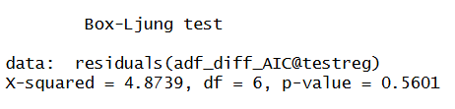

1st ▲ – ADF Unit Root Test
ADF test
Box-Ljung test
Test serial correlation for ADF test:
$$if p−value>0.05 →No serial correlation$$
$$0.5601>0.05 →Failed to Reject → No serial correlation$$
$$tau3_{stat}\text{ v}s{ tau3}_{crit_region(5\%)}$$
$$−5.16<−2.93 →Reject Null$$
Errors are not serial correlated – this is expected from ADF test.
Errors are sufficiently white noise (pure random)
Model has extracted all predictable structure from series with only 1 lag term (via AIC selection)
Null Hypothesis of “there is a unit root”
Rejected null hypothesis “series is non-stationary” highly indicative series is stationary
If KPSS test doesn’t reject its null, then series is confirmed stationary

Slide 24
Formal KPSS Hypothesis Testing
KPSS asks, “is the series stationary?”

Slide 25
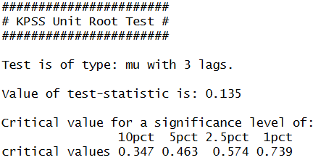
1st ▲ – KPSS TEST

Slide 26

1st ▲ – KPSS TEST
KPSS test
$${tau3}_{KPSS_stat} vs {tau3}_{crit_region(5\%)}$$
$$0.13<0.46 →failed to reject$$
Didn’t reject “1st ▲ is stationary”
Highly suggestive series is stationary as ADF test rejected “1st ▲ is non-stationary”

Slide 27
Forecast Models

Slide 28
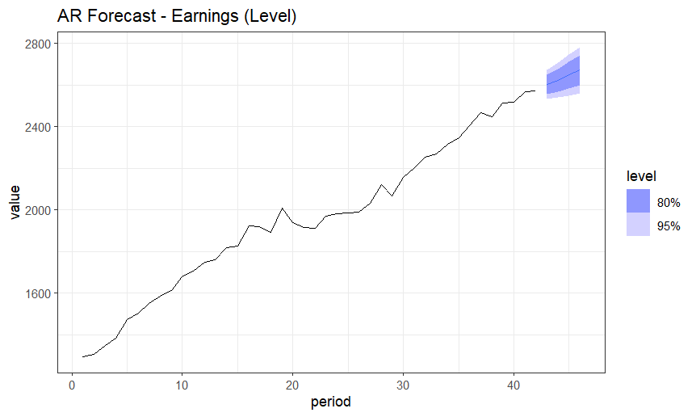
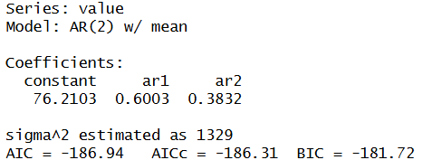






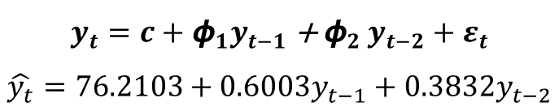

Level - forecast (AR & ARIMA)
$$y_{t}=c+{\text{ϕ}}_{1}y_{t−1}{\text{+ }\text{ϕ}}_{2}y_{t−2}+ε_{t}$$
$$\hat{y_{t}}=76.2103+0.6003y_{t−1}+{0.3832y}_{t−2}$$

Slide 29
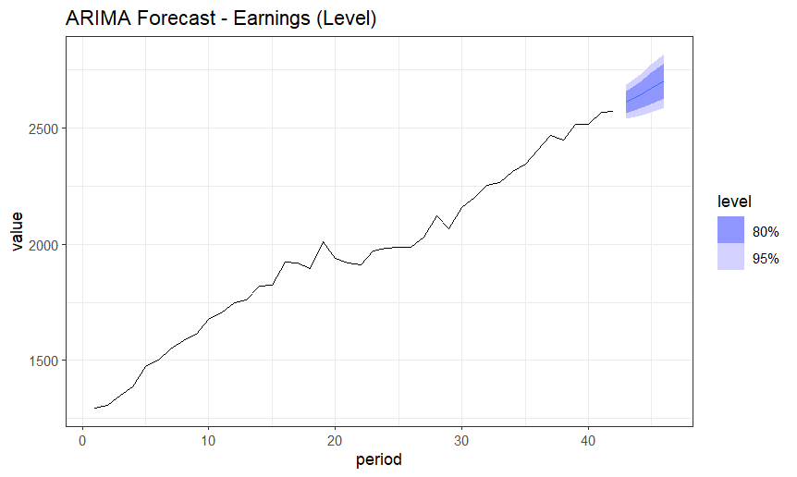
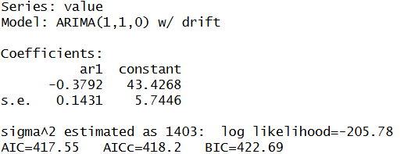











Level - forecast (AR & ARIMA)
$$y_{t}=c+{\text{ϕ}}_{1}y_{t−1}{\text{+ }\text{ϕ}}_{2}y_{t−2}+ε_{t}$$
$$\hat{y_{t}}=76.2103+0.6003y_{t−1}+{0.3832y}_{t−2}$$
$$\text{Δ}y_{t}=c+{\text{ϕ}}_{1}{\text{Δ}y}_{t−1}+ε_{t}$$
$$\text{Δ}\hat{y_{t}}=43.4268−\text{0.3792}\text{Δ}y_{t−1}$$

Slide 30
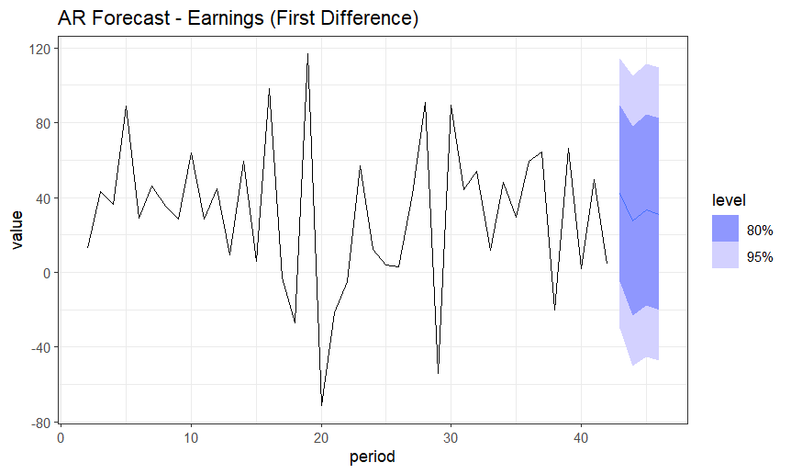
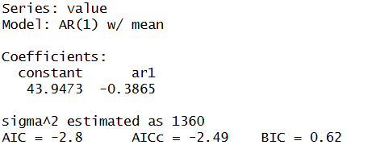






1ST DIFFERENCE - forecast (AR & ARIMA)
$$\text{Δ}y_{t}− μ={\text{ϕ}}_{1}{\text{(}\text{Δ}y}_{t−1}− μ)+ε_{t}$$
$$\text{Δ}\hat{y_{t}}−43.9473=−0.3865{\text{(}\text{Δ}y}_{t−1}− 43.9473)$$

Slide 31
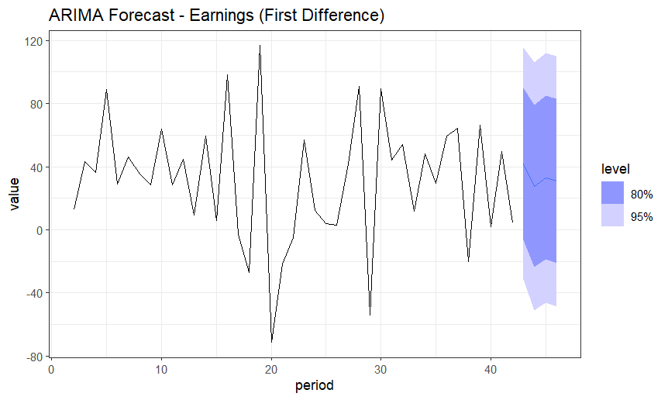
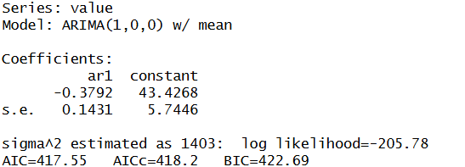










1ST DIFFERENCE - forecast (AR & ARIMA)
$$\text{Δ}y_{t}− μ={\text{ϕ}}_{1}{\text{(}\text{Δ}y}_{t−1}− μ)+ε_{t}$$
$$\text{Δ}\hat{y_{t}}−43.9473=−0.3865{\text{(}\text{Δ}y}_{t−1}− 43.9473)$$
$$\text{Δ}y_{t}=c+{\text{ϕ}}_{1}{\text{Δ}y}_{t−1}+ε_{t}$$
$$\text{Δ}\hat{y_{t}}=43.4268−\text{0.3792}\text{Δ}y_{t−1}$$

Slide 32
Other interesting Findings
Explored median vs mean - no ABS time series exists

Slide 33
Conclusion
Level series: non-stationary, random walk w/ drift
First difference: stationary (ADF, KPSS, Box-Ljung all agree)
AR on raw level was mis-specified - ARIMA(1,1,0) w/ drift corrected this
AR & ARIMA converge on differenced series → AR(1) sufficient, no MA needed
Forecasts reflect this: level trends w/ widening bands, difference reverts to mean

Slide 34
Thank
You
Ali Alkhatib
  34395873
  aalk0011@student.monash.edu
  Applied Timeseries Econometrics/Forecasting

Slide 35
1st Difference – KPSS TEST
5% Confidence Interval Test – Failed to Reject
tau3_KPSS-stat vs tau3_crit(5%):
0.135 < 0.463 → test stat is not more than crit region
Fail to reject Null Hypothesis of “series is stationary”
Agrees with ADF test that indicated series is stationary by rejecting the null hypothesis that the series is “non-stationary”
Notes on how test is conducted
type = 'mu' — tests stationarity around a constant mean (µ). This is due to the 1st difference series having no clear trend - it just fluctuates around some fixed level.

Slide 36
1st Difference - ADF Unit Root Test
5% Confidence Interval Test - Rejected
tau2_ADF-stat vs tau2_crit(5%):
-5.1675 < -2.93 → test stat is more negative
Reject Null Hypothesis of “there is a unit root”
1st Difference Series is stationary

